Slide 1
Retention in the Classroom
Patterns of Student Behavior

Slide 2
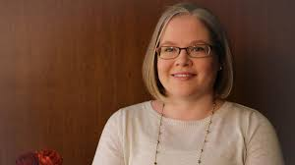
HELLO!
I am Dr. Kristen Harris
This is my 8th year at Spalding and my 1st year as Chair of the College of Education.

Slide 3
COE Quality Assurance System (QAS)
Our accreditation requires us to have a QAS and use data to continuously improve our educator preparation programs. Two key pieces of our QAS are our dispositions process and tracking student progress via gates.

Slide 4
COE Data Days
Twice per academic year, the COE Faculty have a data retreat where we look at our QAS data, especially dispositions and gates, to make continuous improvement plans.
We often refer to the data throughout the year, but these two dedicated days are timed for reflection on changes and initiatives we can implement.

Slide 5
Dispositions Process
Dispositions are defined as, “Professional attitudes, values, and beliefs demonstrated through both verbal and non-verbal behaviors as educators interact with students, families, colleagues, and communities” (Hallam, 2009, p. 27). Education programs have been assessing dispositions for decades, but this assessment is often a perfunctory task or checklist item.
At Spalding, the COE assesses dispositions multiple times per year as a way to help advise and coach students who are in our want to be admitted to our major programs. The assessment is only the first part of a potentially intensive process of supporting students to success.

Slide 6
Dispositions Data
We use an electronic survey form to collect the dispositions rating. The link is emailed to all faculty (full time and adjunct) with other end of semester to dos. We encourage faculty to include comments, especially if they mark Have Concerns to Address. Dispositions data is requested after grades are due and is not evaluative.
Data is exported to a spreadsheet and highlighting rules are applied. I also preview points of concern. The spreadsheet is projected for all to see during the data retreat. The conversation centers around how to support student growth in any areas of concern and to highlight positive comments about students.

Slide 7
Tough Conversations
Though educator dispositions derive from research, they are not without subjectivity that can feel controversial. As such, we actively work as a faculty to challenge when our own and others’ biases seem to be influencing our conversations or the comments we see. We also focus on the student and what is in their best interest, giving grace and space for all to be human, make mistakes, and need help. Context matters, and we try to look holistically when deciding how to proceed with student support.

Slide 8
Gates Data
We also track student progress through sections of the program, called gates. The first gate is admission to the COE and the last gate is program completion. In between those two gates, we monitor student course progression and admission to co-teaching.
We track test scores, GPA, credit hours, and registration holds. This is a repackaging of data from our IE Unit Masterlist, and if/when we need more context about a student, we move to the full Masterlist.
Advising notes are also very helpful as we review students in each type of program. Shout out to Academic Advising and Support!

Slide 9
Seeing the Patterns
By the time we’ve collected and reviewed the dispositions and gates data, patterns have started to emerge:
The same students have come up in conversation multiple times
A student who needed support previously has come up again
A student on was on an action plan has made progress on goals
From here, we develop our plans. Which students will be contacted by which faculty, by the Chair? Is there an area of concern COE-wide that can be addressed in classes? Was the data robust enough? Are all faculty adding to our understandings? What else do we wish we knew about students?

Slide 10
Seeing the Patterns
Doing this for five years now, we have learned:
The more concerns/holds/issues facing a student, the less likely they are to complete our program.
Many students with dispositions concerns in the first three EDU classes also have low GPAs. They tend to change their major and/or leave Spalding; this is okay and not everyone is meant to teach.
Graduate and undergraduate students tend to face different retention challenges. More financial issues for our grad students, GPA and testing issues for undergrads.
Our action plans are not always successful. Those situations hurt the most.

Slide 11
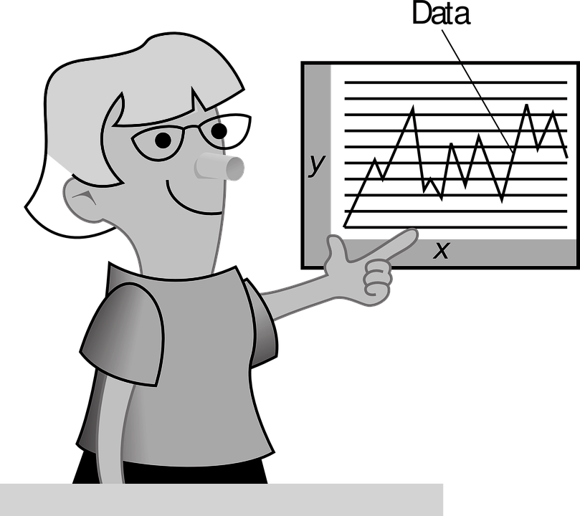
“The goal is to turn data into information , and information into insight.”
Carly Fiorina, ex CEO of Hewlett-Packard

Slide 12
THANK YOU

Slide 13
References
Hallam, M. K. (2009). Another piece of the language learning
puzzle: Why teacher dispositions are a crucial aspect of
student success. The Language Educator, 4(1), 26–29.

